Slide 1

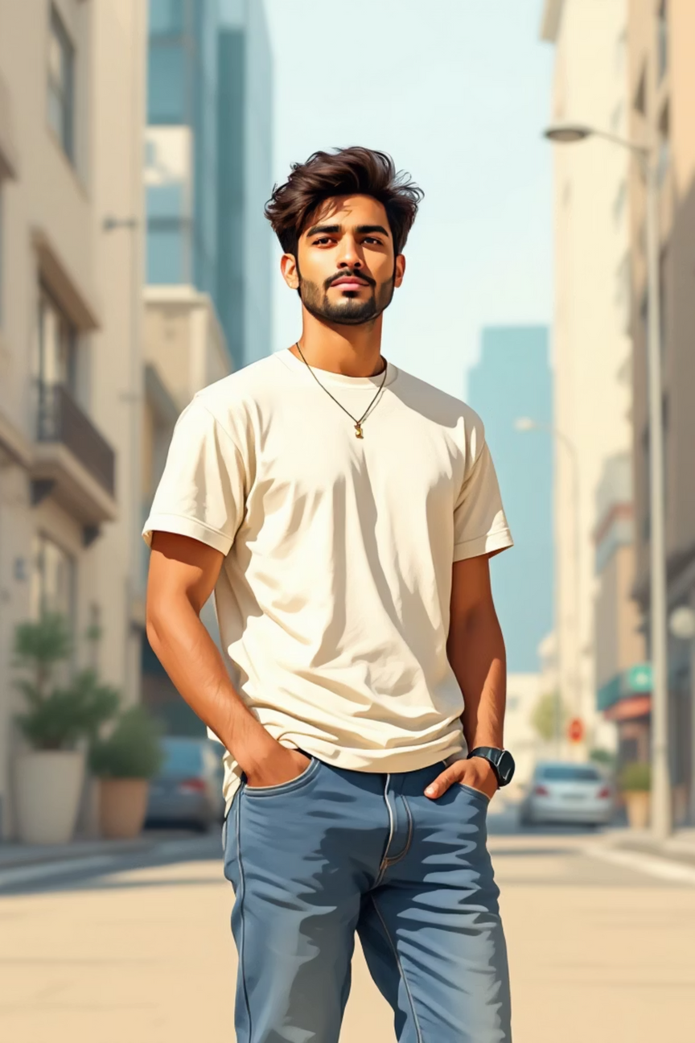

GharKVastra
GharKVastra is a men's fashion brand built on a simple belief — fashion should feel natural. We focus on comfort, quality, and everyday style that fits seamlessly into your life.
Wear What Feels Like Home.

Slide 2
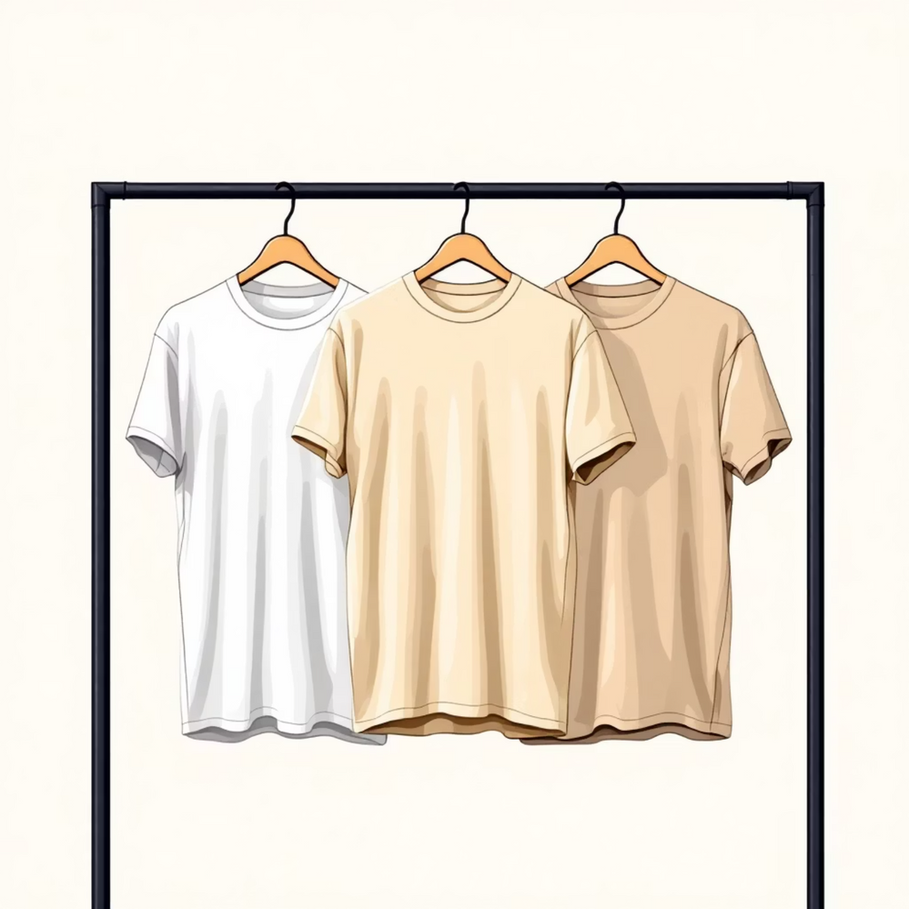
Brand Overview
What We Do
GharKVastra specializes in T-shirts and jeans designed for everyday wear. We combine modern style with lasting comfort, creating pieces that work for the daily lifestyle of young Indian men.
Our focus is simple: quality basics that feel good, look sharp, and stand the test of time.

Slide 3



Brand Mission
High-Quality Apparel
Practical & Accessible
True to Our Values
Deliver comfortable and stylish men's clothing that meets the highest standards of craftsmanship and material quality.
Make fashion practical, accessible, and trustworthy for every young man seeking reliable everyday essentials.
Stay authentic in our commitment to comfort, durability, and honest relationships with our customers.

Slide 4
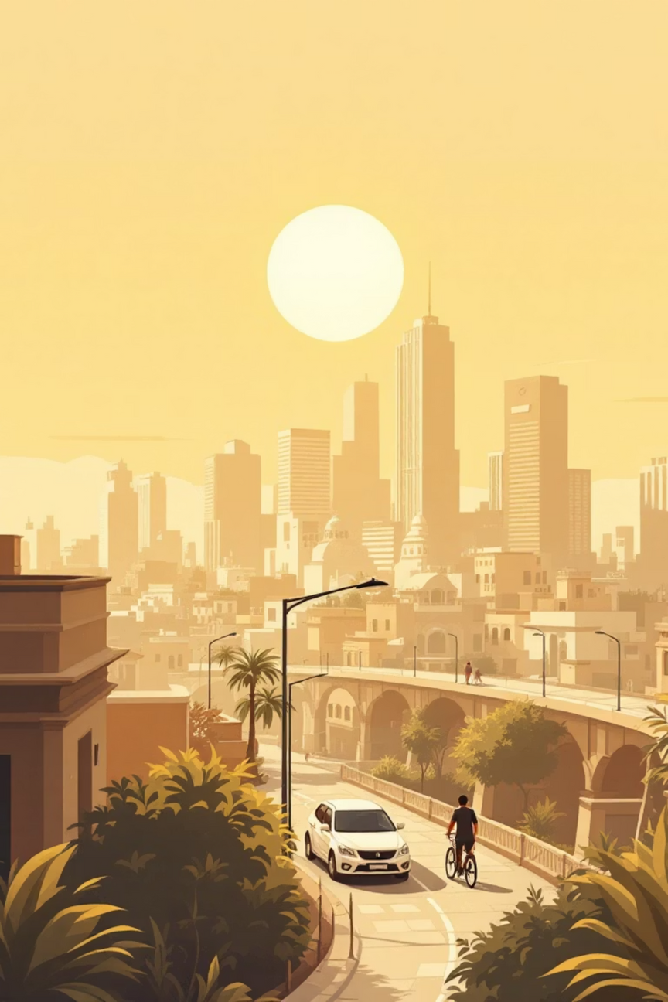



Brand Vision
Leading Men's Lifestyle Brand
Become a leading name in India's men's fashion landscape, recognized for quality and consistency.
Timeless Essentials
Be known for creating timeless, reliable wardrobe essentials that transcend seasonal trends.
Customer Trust
Build long-term customer relationships through consistent quality, transparent practices, and honest pricing.

Slide 5




Brand Personality
GharKVastra embodies the spirit of modern India — confident yet grounded, stylish yet comfortable. Our personality reflects who our customers are and aspire to be.
Confident & Authentic
Modern & Dependable
We stand by our products and values, never compromising on what matters most to our customers.
Contemporary designs that you can count on, day after day, season after season.
Stylish, Not Flashy
Indian at Heart
Style-focused without being loud or pretentious — understated excellence in every piece.
Rooted in Indian values with a contemporary outlook that resonates with today's generation.

Slide 6
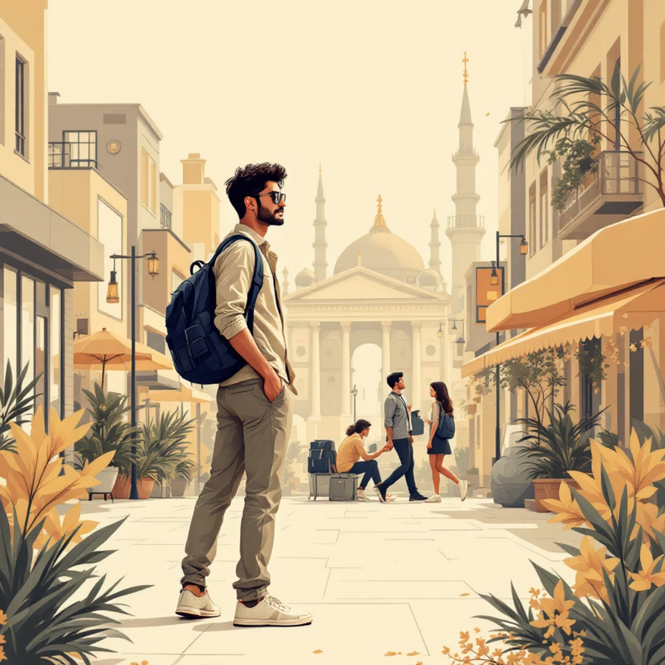
Target Audience
Who We Serve
Our core audience is men aged 18–35 years — college students navigating campus life and early-career professionals building their futures. They're found in urban centers and semi-urban areas across India.
These are young men who value comfort, durability, and everyday style. They want clothes that work as hard as they do, without sacrificing how they look or feel.
They're practical, style-conscious, and looking for brands that understand their lifestyle and respect their budget.

Slide 7

Brand Voice
Clear & Confident
We communicate with clarity and conviction, speaking directly and honestly about what we offer.
Friendly Yet Professional
Approachable and warm, but always maintaining respect and professionalism in every interaction.
Minimal & Modern
Every word serves a purpose. Our messaging is contemporary, purposeful, and free of unnecessary fluff.
Relatable
We speak the language of the everyday Indian consumer, understanding their needs and aspirations.

Slide 8
Tone Guidelines – Do's
Use Simple and Clear Language
Highlight Comfort and Quality
Avoid jargon and complexity. Speak in a way that everyone can understand and relate to immediately.
Always emphasize the core values that set us apart — the comfort of our fabrics and the quality of our construction.
Communicate Honestly and Consistently
Maintain Professional, Approachable Tone
Build trust through transparent communication. Say what you mean, mean what you say, and stay consistent across all touchpoints.
Strike the balance between being accessible and maintaining credibility. Be the friend who gives solid advice.

Slide 9
Tone Guidelines – Don'ts
Avoid Exaggerated Messaging
Skip Forced Slang & Overpromising
No aggressive claims or over-the-top promises. Stay grounded in what we can actually deliver.
Don't try too hard to be "cool" or make unrealistic guarantees. Authenticity beats pretense every time.
Keep It Simple
Stay Consistent
Avoid complex or confusing language that makes customers work to understand your message.
Don't shift your tone across different platforms. Whether it's Instagram, email, or in-store, we're the same brand.

Slide 10
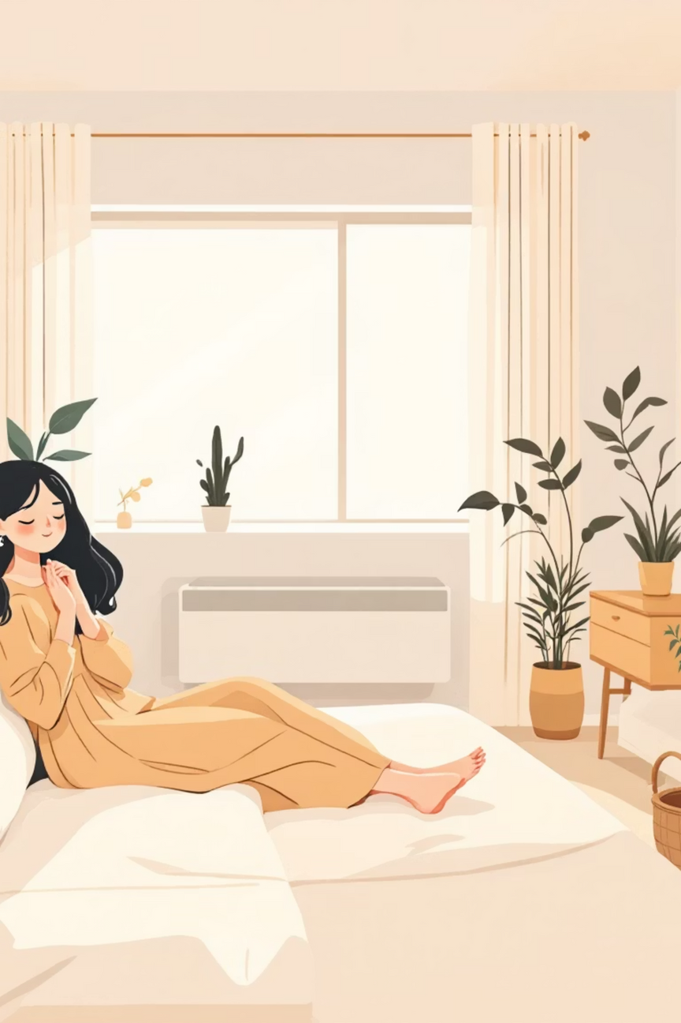
CONCLUSION
GharKVastra represents everyday confidence and comfort. Our brand focuses on honest fashion that feels familiar, reliable, and effortless — clothing that fits naturally into your life.
We're here for the moments that matter and the days that don't make headlines. We're here for comfort that lasts and style that endures.
GharKVastra
Wear What Feels Like Home.

